Slide 1

Minimal APIs in the Field
Make ASP.NET Core Minimal APIs work in your LOB apps
Digital Craftsmanship Nordoberpfalz 13.12.2022
Kenny Pflug

Slide 2
Content
Where is all my code?
Structuring HTTP endpoints with Minimal APIs in a real-world project
Endpoint Registration
Model Binding and Dependency Injection
Supporting OpenAPI / Swagger
Automated Testing of Minimal API endpoints
Validation of parameters and DTOs
Patterns and Practices
Miscellaneous topics: auth, performance, what’s new in .NET 7
Your questions

Slide 3
Minimal APIs with ASP.NET Core
Where is all my code?

Slide 4
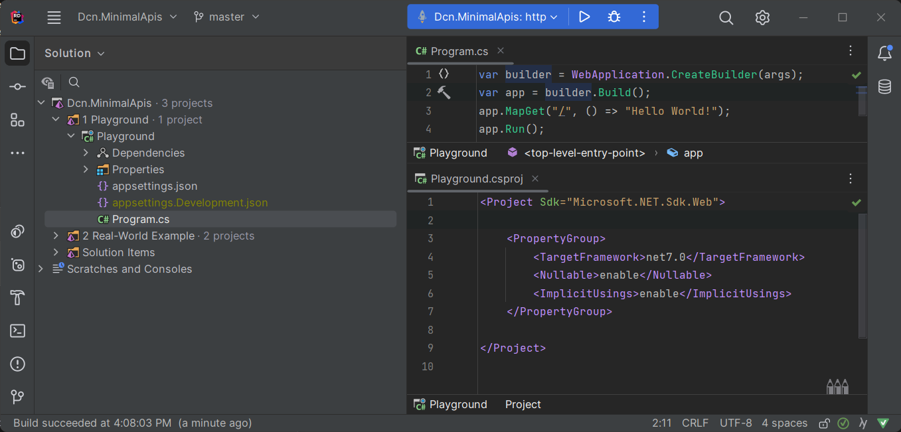
Minimal APIs – Default Template

Slide 5
CreateHostBuilder and Startup are gone
public static class Program
{
public static void Main(string[] args)
{
CreateHostBuilder(args).Build().Run();
}
public static IHostBuilder CreateHostBuilder(string[] args) =>
Host.CreateDefaultBuilder(args)
.ConfigureWebHostDefaults(builder => builder.UseStartup<Startup>());
}
public class Startup
{
public void ConfigureServices(IServiceCollection services)
{
services.AddAuthentication();
services.AddMvc();
}
public void Configure(IApplicationBuilder app,
IWebHostEnvironment environment)
{
if (environment.IsDevelopment())
app.UseDeveloperExceptionPage();
app.UseRouting()
.UseAuthentication()
.UseEndpoints(builder => builder.MapControllers());
}
}
WebApplicationBuilder
WebApplication

Slide 6


ASP.NET Core Middleware Pipeline
HTTP Request
Developer Exception
Page
Middleware
Serilog
Request
Logging
Middleware
Routing Middleware
Swagger Middleware
Endpoint Middleware
(Minimal APIs)
Kestrel
HTTP
Server
HTTP Response

Slide 7

Live Demo
Turning a Minimal API project back to normal

Slide 8
Global Using Directives for Web SDK
using System;
using System.Collections.Generic;
using System.Linq;
using System.Net.Http;
using System.Net.Http.Json;
using Microsoft.AspNetCore.Builder;
using Microsoft.AspNetCore.Hosting;
using Microsoft.AspNetCore.Http;
using Microsoft.AspNetCore.Routing;
using Microsoft.Extensions.Configuration;
using Microsoft.Extensions.DependencyInjection;
using Microsoft.Extensions.Hosting;
using Microsoft.Extensions.Logging;
Source: https://github.com/dotnet/aspnetcore/issues/32451#issuecomment-870812382

Slide 9
Structuring HTTP Endpoints

Slide 10
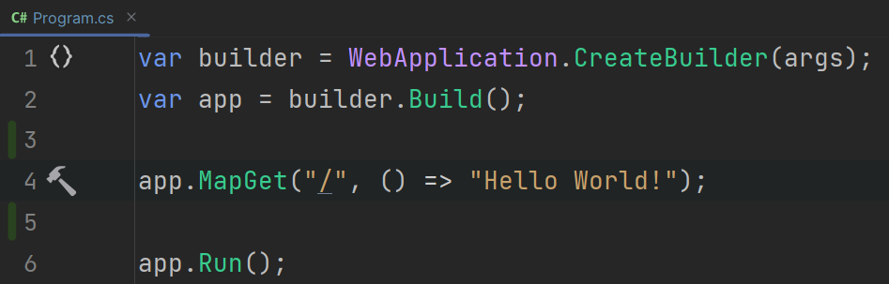
Mapping Endpoints with Delegates
The MapXXX methods take a delegate that will be called when a corresponding HTTP Request is received
The delegate can point to an anonymous method / lambda, or any other type of static or instance method
Internally, the delegate is registered in the endpoint middleware

Slide 11
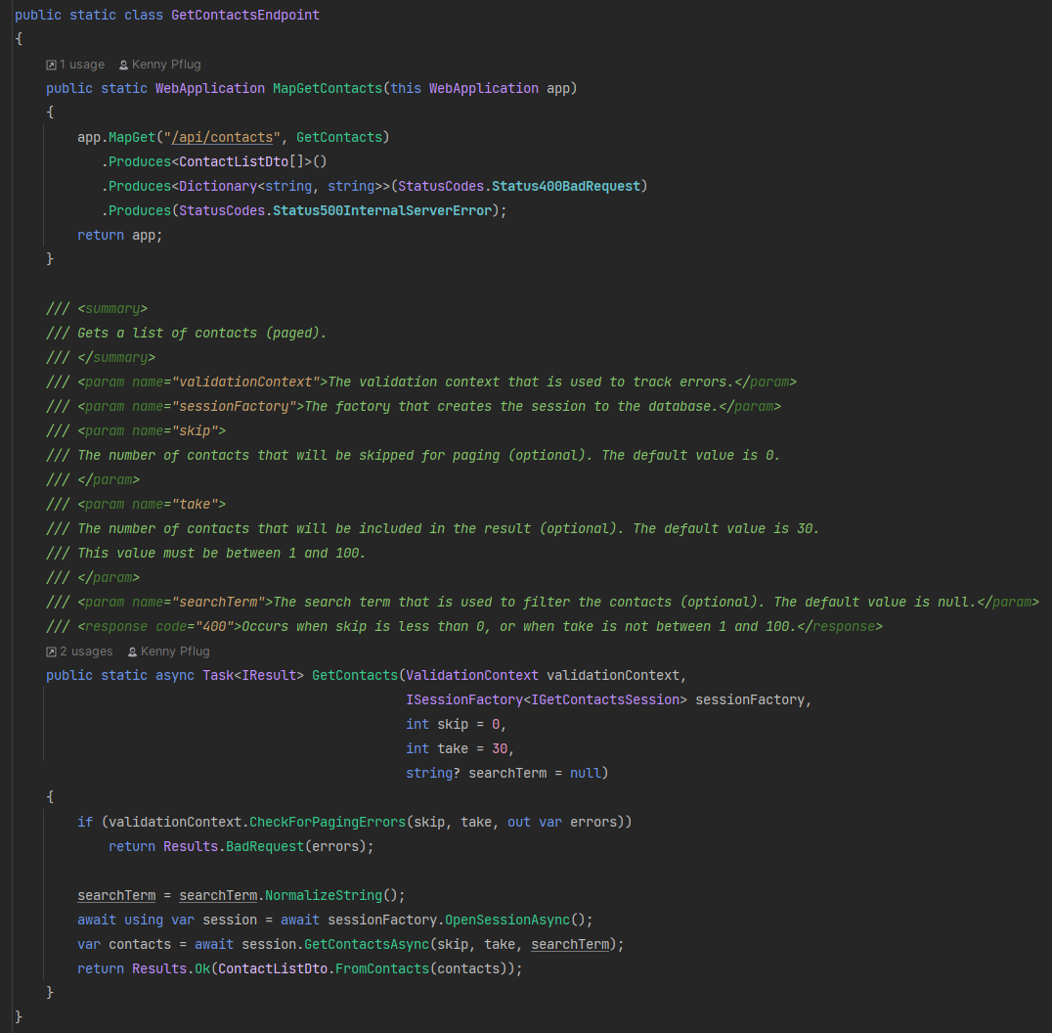
How to organize endpoints?
The endpoint methods can be called from unit tests without setting up the whole HTTP server
These methods should not be within a single Program.cs
I prefer one endpoint per file/class, but you can also achieve several endpoints per file
Another tip: create namespaces per use case, not for endpoints, data access, interfaces, enums, classes, etc.

Slide 12
CHUC: Core – Humble Objects – Unit Tests – Composition Root
Process Boundary
Abstraction
Humble Objects (Test Doubles)
Core
Unit Tests
Composition Root

Slide 13
Live Demo
Real-life project overview

Slide 14
Endpoint Registration

Slide 15
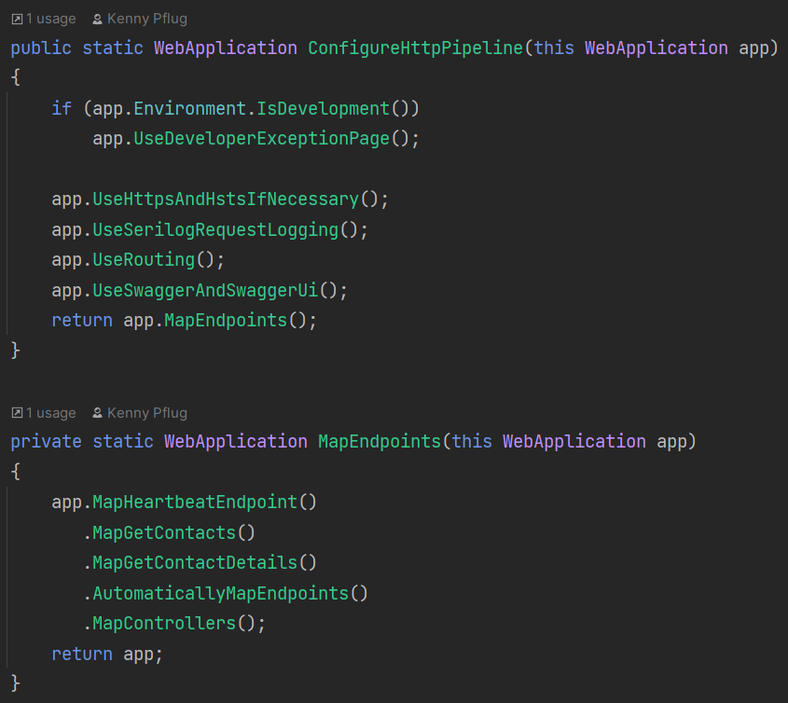
Two ways to register: manual vs. automatic
By default, endpoints are registered by explicitly calling a MapXXX method
There is no mechanism to discover and register endpoints automatically, but you can handroll your own
Be aware: automatic endpoint registration usually involves the use of Reflection – this might hurt you in AoT scenarios
Automatic registration might also be done via a Source Generator
I prefer manual registration

Slide 16
Live Demo
Automatic endpoint registration

Slide 17
Dependency Injection and Model Binding

Slide 18
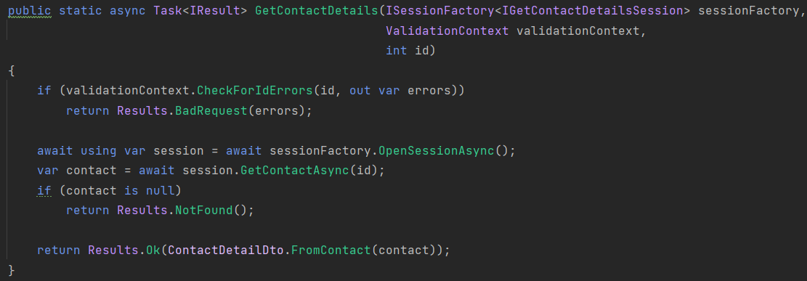
DI via Method Injection and Model Binding
By default, dependencies to other objects will be passed via Method Injection next to the regular parameters from the query or body of the request
These service dependencies reside right next to the arguments that represent query parameters or DTOs deserialized from the JSON body of the request
Transient or scoped services must be injected this way
Model binding works in a similar way to ASP.NET Core MVC
You do not need to decorate parameters with [FromBody] or [FromServices]

Slide 19
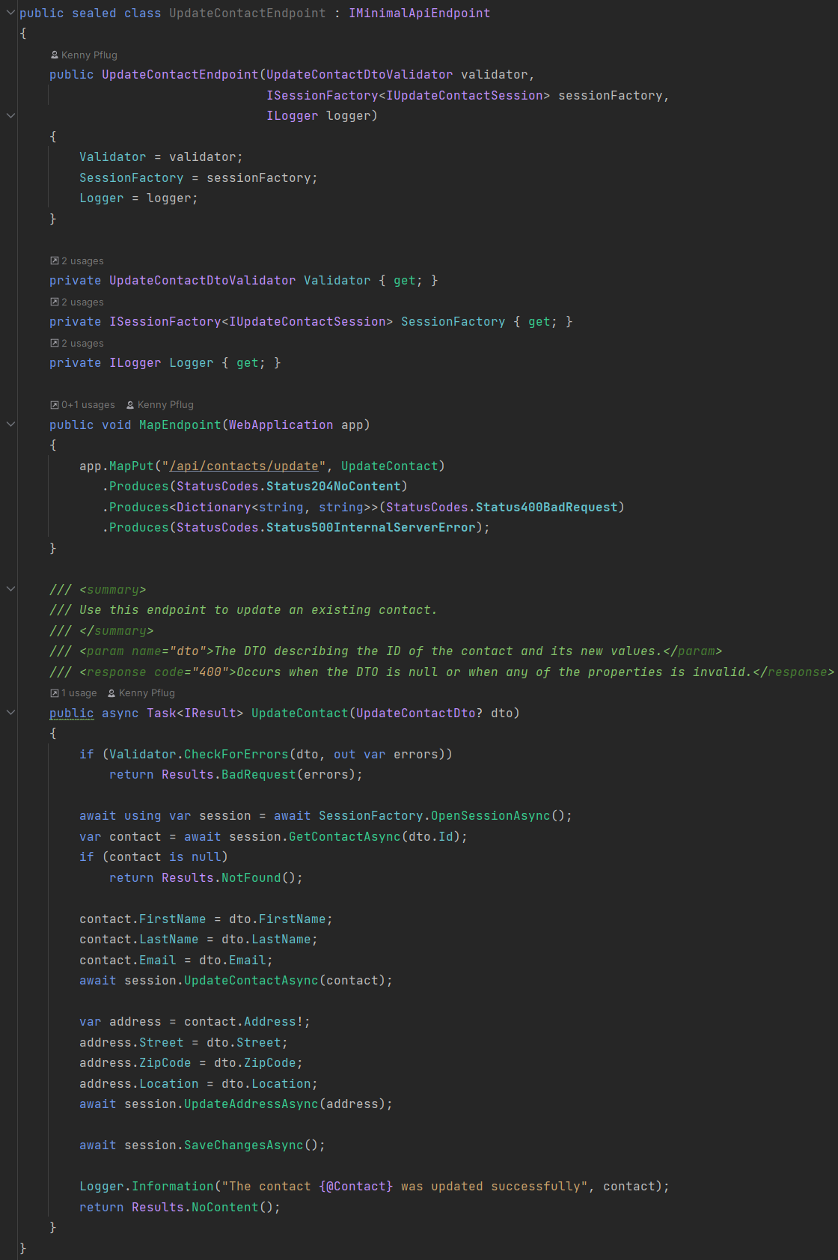
Injecting Singletons via the constructor
If you have an automatic registration mechanism that’s based on instantiating objects implementing a certain abstraction, you can use it to inject dependencies via the constructor
The result looks pretty much like ASP.NET Core MVC Controllers
Beware: the dependencies become singletons when the mapped endpoint delegate references the object

Slide 20
Swagger Support

Slide 21
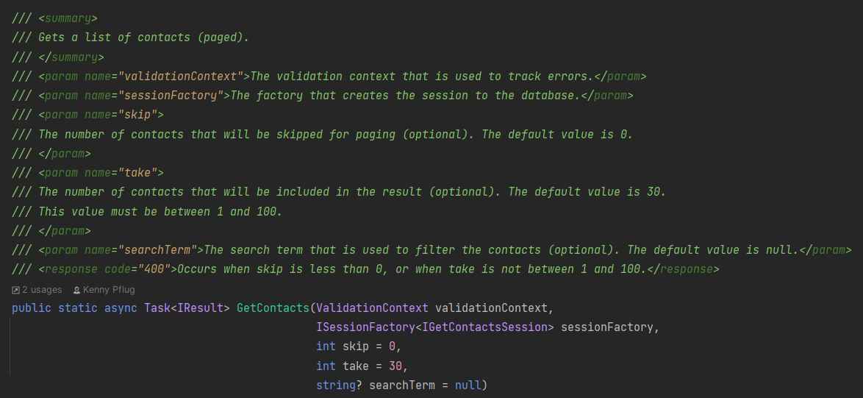
AspNetCore.Swashbuckle with Minimal APIs
The mapped delegates of Minimal APIs will be added to ASP.NET Core’s endpoints API explorer
When using methods, Swashbuckle can pick up the XML comments of those for documentation purposes
Configuration of Swagger/OpenAPI is not that different from ASP.NET Core MVC

Slide 22
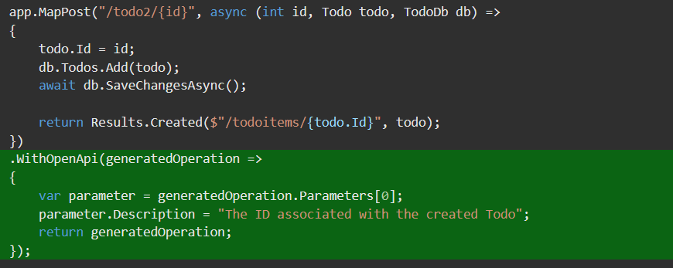
Swagger with anonymous methods in .NET 7
With the new Microsoft.AspNetCore.OpenApi NuGet package, you can imperatively describe your Web API endpoint
You can also mix this with the previously shown approach
https://github.com/dotnet/AspNetCore.Docs/pull/25863

Slide 23
Automated Testing of Minimal API endpoints

Slide 24
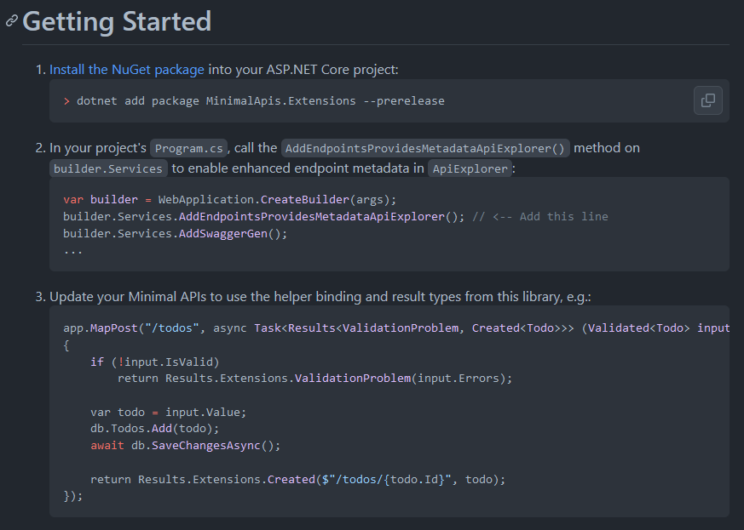
IResult was hard – but now, it’s fine
The IResult implementations are internal and cannot be accessed in unit tests
Damien Edwards create MinimalApis.Extensions which also contains public implementations
We ended up creating our own because of some discrepancies: https://github.com/Synnotech-AG/Synnotech.AspNetCore.MinimalApis
Since .NET 7, the classes implementing IResult are public

Slide 25
Live Demo
Unit testing for Minimal APIs

Slide 26
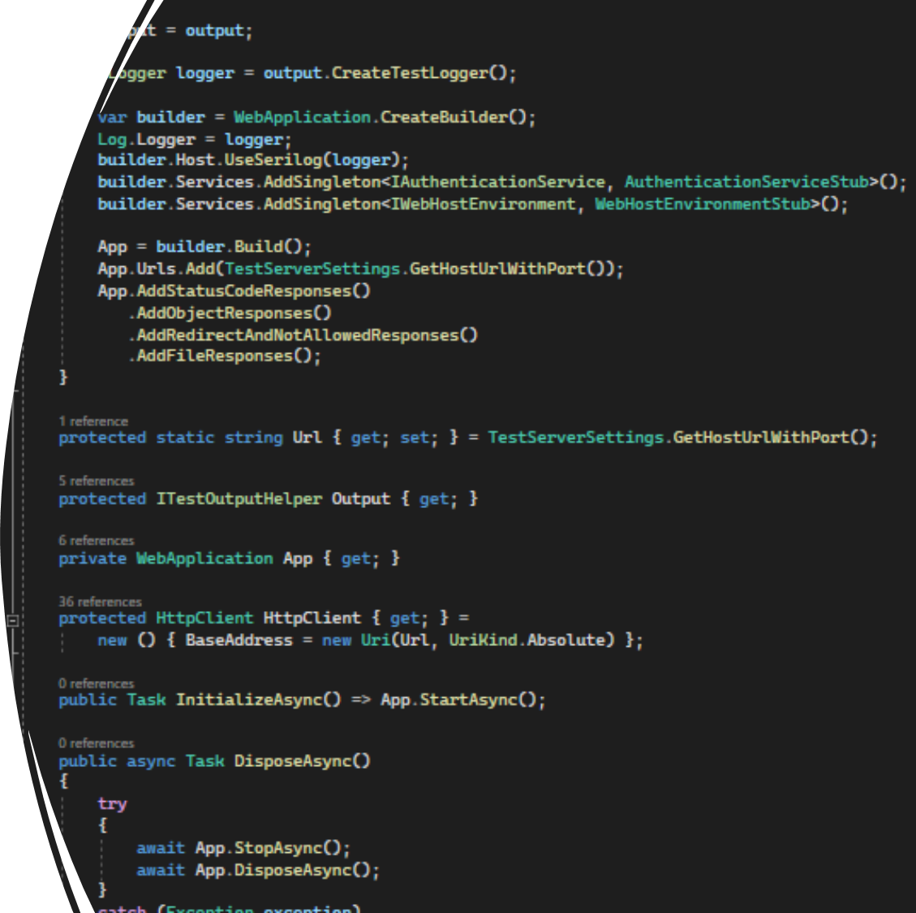
Integration testing for the whole middleware pipeline
Microsoft suggests using the WebApplicationFactory<T> (where T is either a Program or a Startup class)
We ended up writing our own base class for better integration with Xunit logging and more control over the configuration of the composition root

Slide 27
Validation of Query Parameters and Data Transfer Objects

Slide 28
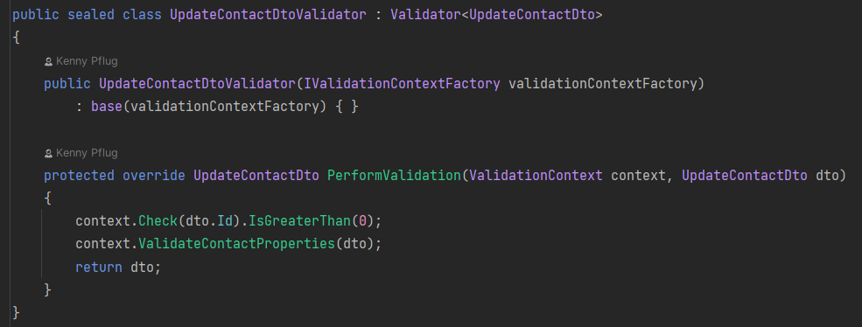
No built-in validation
Minimal APIs don’t contain any validation mechanism by default
MinimalApis.Extensions adapts System.ComponentModel.DataAnnotations with Validated<T>
FluentValidation has no integration for minimal APIs yet (ValidationResult must be converted into something useful for the response body)
I ended up creating Light.Validation

Slide 29
Live Demo
Validation of parameters and DTOs

Slide 30
Miscellaneous infos and conclusion

Slide 31
Miscellaneous infos
Minimal APIs is about 5% to 12% faster than ASP.NET Core MVC
Auth works pretty much the same way as in ASP.NET Core MVC
.NET 7 introduces
Filters
Route Groups
File Upload
OpenAPI support for anonymous methods
Public IResult implementations
Enhanced model binding support for headers, query strings, and request bodies

Slide 32
Conclusion
Should you immediately switch to Minimal APIs? Probably not. The performance improvements might be relevant for you in Cloud scenarios.
Will Minimal APIs become important? Probably yes, it will become the main framework for building Web APIs in the upcoming years.
Should you use anonymous methods as endpoints? Probably not – no unit testing support. Might make sense in a Microservice environment.
Should you place all endpoints in Program.cs? No, probably not – that doesn’t scale well. You will have more merge conflicts and bloat up the file. Might make sense in a Microservice environment.
You can run ASP.NET Core MVC alongside Minimal APIs – thus you can transition slowly in existing projects.

Slide 33
Thank you!
Got any questions?

